Slide 1
UNMANNED AERIAL VEHICLE FOR CRIME DETECTION AND RESCUE
PROJECT SUPERVISOR:
Ms.Suruthi S
Assistant Professor
Group No: 13
By:
Allwin Meshach Hezron T 310620106012
Bhuvaneshwaran L 310620106021

Slide 2
OUTLINE
OBJECTIVES
INTRODUCTION
PROPOSED METHODOLOGY
BLOCK DIAGRAM
LITERATURE SURVEY
HARDWARE REQUIREMENTS
EXPECTED OUTCOMES
CONCLUSION
REFERENCES – PEER REVIEWED JOURNALS ONLY

Slide 3
OBJECTIVES
The objective of this project is to create an self navigating, highly effective security and rescue system using UAV.
This system aims to significantly enhance evidence across the entire area or unit space by providing real-time surveillance and monitoring.

Slide 4
INTRODUCTION
What are UAVs?
UAV stands for Unmanned Aerial Vehicles, are autonomous aircraft that operate without a human pilot onboard.
They can be controlled remotely or operate autonomously using pre-programmed flight paths.
Key Features:
UAVs have a wide range of applications across industries, from agriculture to defense and beyond.
UAVs can adapt to changing situations and optimize their operations in real-time, making them highly flexible.
They enhance wireless networks by serving as aerial base stations, providing coverage where needed.

Slide 5
PROPOSED METHODOLOGY
•Develope a UAV with long flight time which is suitable for the crime detection.
•Integrate an advanced autopilot system capable of autonomous flight, obstacle avoidance, and adaptive flight path planning.
•Integrate GSM & GPS modules for seamless communication and data sharing.
•Gather relevant data for the person and crime statistics in the targeted areas.
•Create an algorithm to determine the optimal UAV’s path to the location based on the last transmitted location of the person from the transmitter device.
•Define thresholds for video capture and transmitting.

Slide 6
PROPOSED METHODOLOGY
Normal UAV’s uses RF Signal Transmitter for movements, transmitter range must be limiting factor to ensure satisfactory range in searching.
This RF system was removed and a novel use of Path Planning Algorithms allowed a series of improvements.
The UAV's core capabilities include autonomous flight planning using GPS navigation, on-board image capture, and seamless data transmission to a central server through GSM connectivity.
To add a layer of intelligence to the system, machine learning algorithms are incorporated, enabling the UAV to operate in two distinct modes.

Slide 7
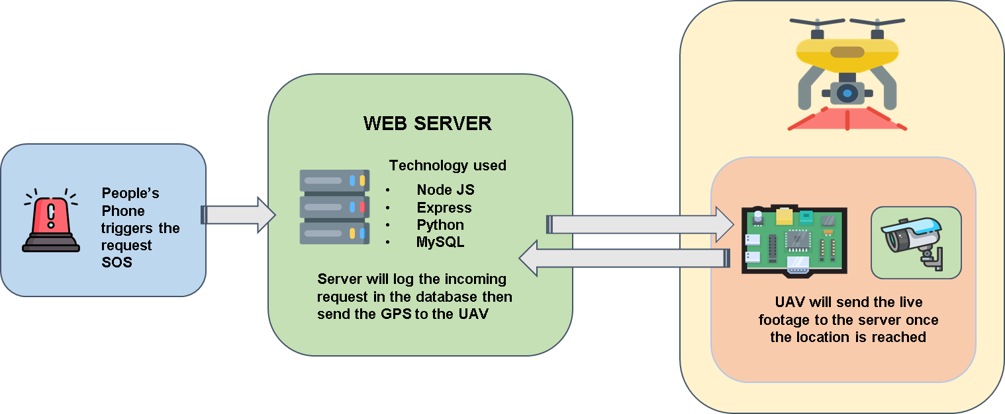
BLOCK DIAGRAM

Slide 8
LITERATURE SURVEY
S.NO | JOURNAL DETAILS | TECHNIQUES USED | INFERENCE
1. | Y. Pan, Q. Chen, N. Zhang, Z. Li, T. Zhu and Q. Han, "Extending Delivery Range and Decelerating Battery Aging of Logistics UAVs Using Public Buses," in IEEE Transactions on Mobile Computing, vol. 22, no. 9, pp. 5280-5295, 1 Sep. 2023, doi: 10.1109/TMC.2022.3167040. | ULRB framework | Extending the monitoring time and reduces the battery usage of the UAV using Public Buses
2. | Y. Zeng, X. Xu, S. Jin and R. Zhang, "Simultaneous Navigation and Radio Mapping for Cellular-Connected UAV With Deep Reinforcement Learning," in IEEE Transactions on Wireless Communications, vol. 20, no. 7, pp. 4205-4220, July 2021, doi: 10.1109/TWC.2021.3056573. | Coverage-aware navigation | UAV’s controllable mobility to design its navigation/trajectory to avoid the cellular coverage holes while accomplishing their missions

Slide 9
LITERATURE SURVEY
S.NO | JOURNAL DETAILS | TECHNIQUES USED | INFERENCE
3. | J. Yoon, A. -H. Lee and H. Lee, "Rendezvous: Opportunistic Data Delivery to Mobile Users by UAVs Through Target Trajectory Prediction," in IEEE Transactions on Vehicular Technology, vol. 69, no. 2, pp. 2230-2245, Feb. 2020, doi: 10.1109/TVT.2019.2962391. | Trajectory prediction, Path planning | UAV perform their own distributed path planning collaboratively over time
4. | S. Zahran, A. M. Moussa, A. B. Sesay and N. El-Sheimy, "A New Velocity Meter Based on Hall Effect Sensors for UAV Indoor Navigation," in IEEE Sensors Journal, vol. 19, no. 8, pp. 3067-3076, 15 April 15, 2019, doi: 10.1109/JSEN.2018.2890094. | (INS) Inertial navigation systems | UAVs became more capable of fulfilling their tasks without any human intervention, by depending on the fusion of its onboard sensors to navigate autonomously

Slide 10
REQUIREMENTS
Hardware Components
1x Flight Controller
4x BLDC motors
4x Electronic Speed Controllers
4x Propeller Blades
1x Raspberry Pi 3
1x Camera Module
4x LIDAR sensors
1x 14.8 volt Rechargeable LiPo Battery
1x UAV Frame
1x Battery Management System
1x GSM & GPS module
1x Battery Charger
Software Technology
Flutter-dart
Node JS
Express JS
Python 3
MySQL

Slide 11
TIMELINE
TIMELINE | PROCESS
August 2023 | Research and Planning
September 2023 | Hardware Selection and Assembly
October 2023 | Autonomous Flight Testing
November 2023 | Sending captured video and path planning algorithm testing
December 2023 | Performance Optimization and Refinement Documentation and Paper Publishing

Slide 12
EXPECTED OUTCOMES
Improved Crime Detection
Faster Response to Emergencies
Enhanced Search and Rescue
Reduced Risk to First Responders
Data Collection and Evidence Gathering
Public Safety and Deterrence
Cost-Efficiency
Interagency Collaboration
Data Analysis and Pattern Recognition
Public Awareness and Trust

Slide 13
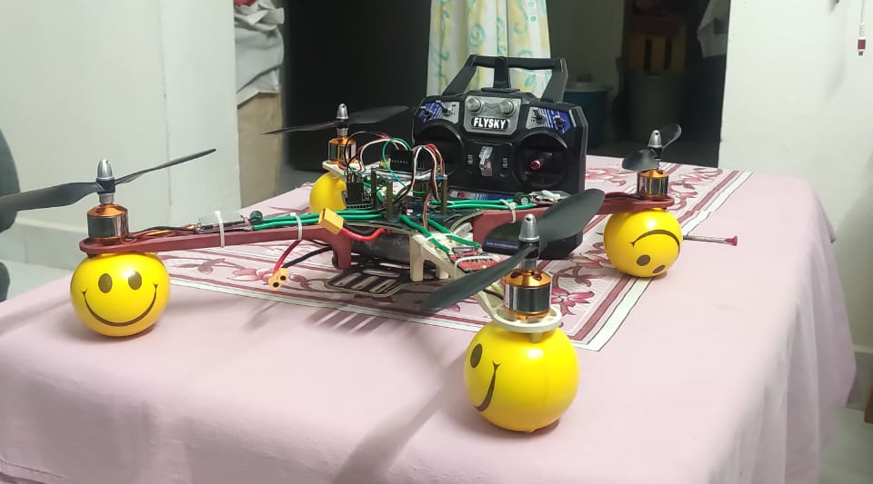
CONCLUSION
Focused on analyzing the UAV’s hardware systems we have achieved the flight systems by controlling the UAV with a flight controller.
On the other hand analyzing the UAV’s software system we achieved the mobile app which sends the gps location to the UAV’s central server.
We have moved to the next step of making the UAV autonomous along with video capturing capabilities.

Slide 14
REFERENCES
Y. Zeng, X. Xu, S. Jin and R. Zhang, "Simultaneous Navigation and Radio Mapping for Cellular-Connected UAV With Deep Reinforcement Learning," in IEEE Transactions on Wireless Communications, vol. 20, no. 7, pp. 4205-4220, July 2021, doi: 10.1109/TWC.2021.3056573.
J. Yoon, A. -H. Lee and H. Lee, "Rendezvous: Opportunistic Data Delivery to Mobile Users by UAVs Through Target Trajectory Prediction," in IEEE Transactions on Vehicular Technology, vol. 69, no. 2, pp. 2230-2245, Feb. 2020, doi: 10.1109/TVT.2019.2962391.
S. Zahran, A. M. Moussa, A. B. Sesay and N. El-Sheimy, "A New Velocity Meter Based on Hall Effect Sensors for UAV Indoor Navigation," in IEEE Sensors Journal, vol. 19, no. 8, pp. 3067-3076, 15 April 15, 2019, doi: 10.1109/JSEN.2018.2890094.
Y. Pan, Q. Chen, N. Zhang, Z. Li, T. Zhu and Q. Han, "Extending Delivery Range and Decelerating Battery Aging of Logistics UAVs Using Public Buses," in IEEE Transactions on Mobile Computing, vol. 22, no. 9, pp. 5280-5295, 1 Sep. 2023, doi: 10.1109/TMC.2022.3167040.

Slide 15


